Slide 1
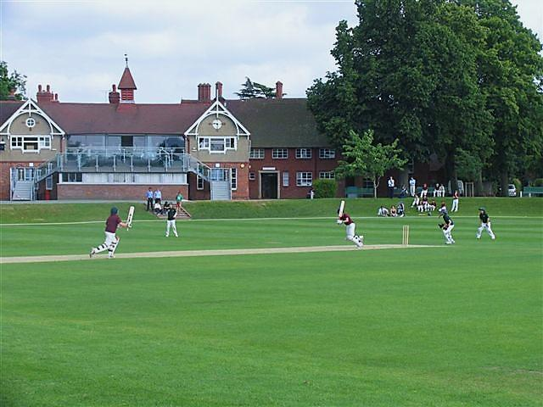
Shropshire Playing Fields Association
Open Space Needs Assessments
David Kilby
SAPCA Conference 8th February 2016

Slide 2
Question
Have you ever considered that significant funding opportunities might have been lost to the Sport and Play Construction Industry, because local planning authorities are failing to provide appropriate, robust, up-to-date “open space needs assessments”, as required by the National Planning Policy Framework?

Slide 3
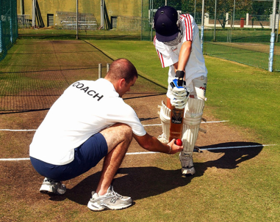
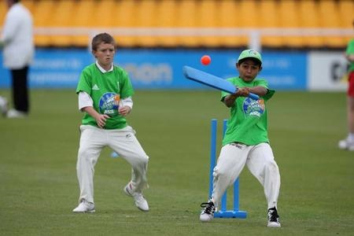
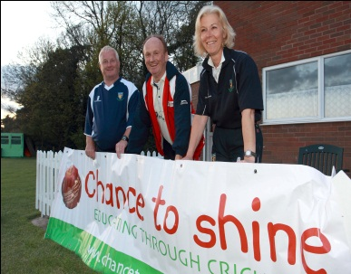
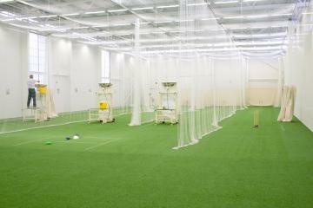
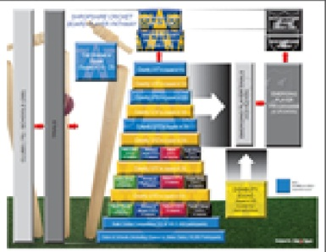
SPORT
PLAY
RECREATION
OPEN SPACES
OPPORTUNITIES
National Planning Policy (Paragraph 73)
‘Access to high quality open spaces and opportunities for sport and recreation can make an important contribution to the health and well-being of communities.
Planning policies should be based on robust and up-to-date assessments of the needs for open space, sports and recreation facilities and opportunities for new provision.
The assessments should identify specific needs and quantitative or qualitative deficits or surpluses of open space, sports and recreational facilities in the local area.
Information gained from the assessments should be used to determine what open space, sports and recreational provision are required.’.’

Slide 4
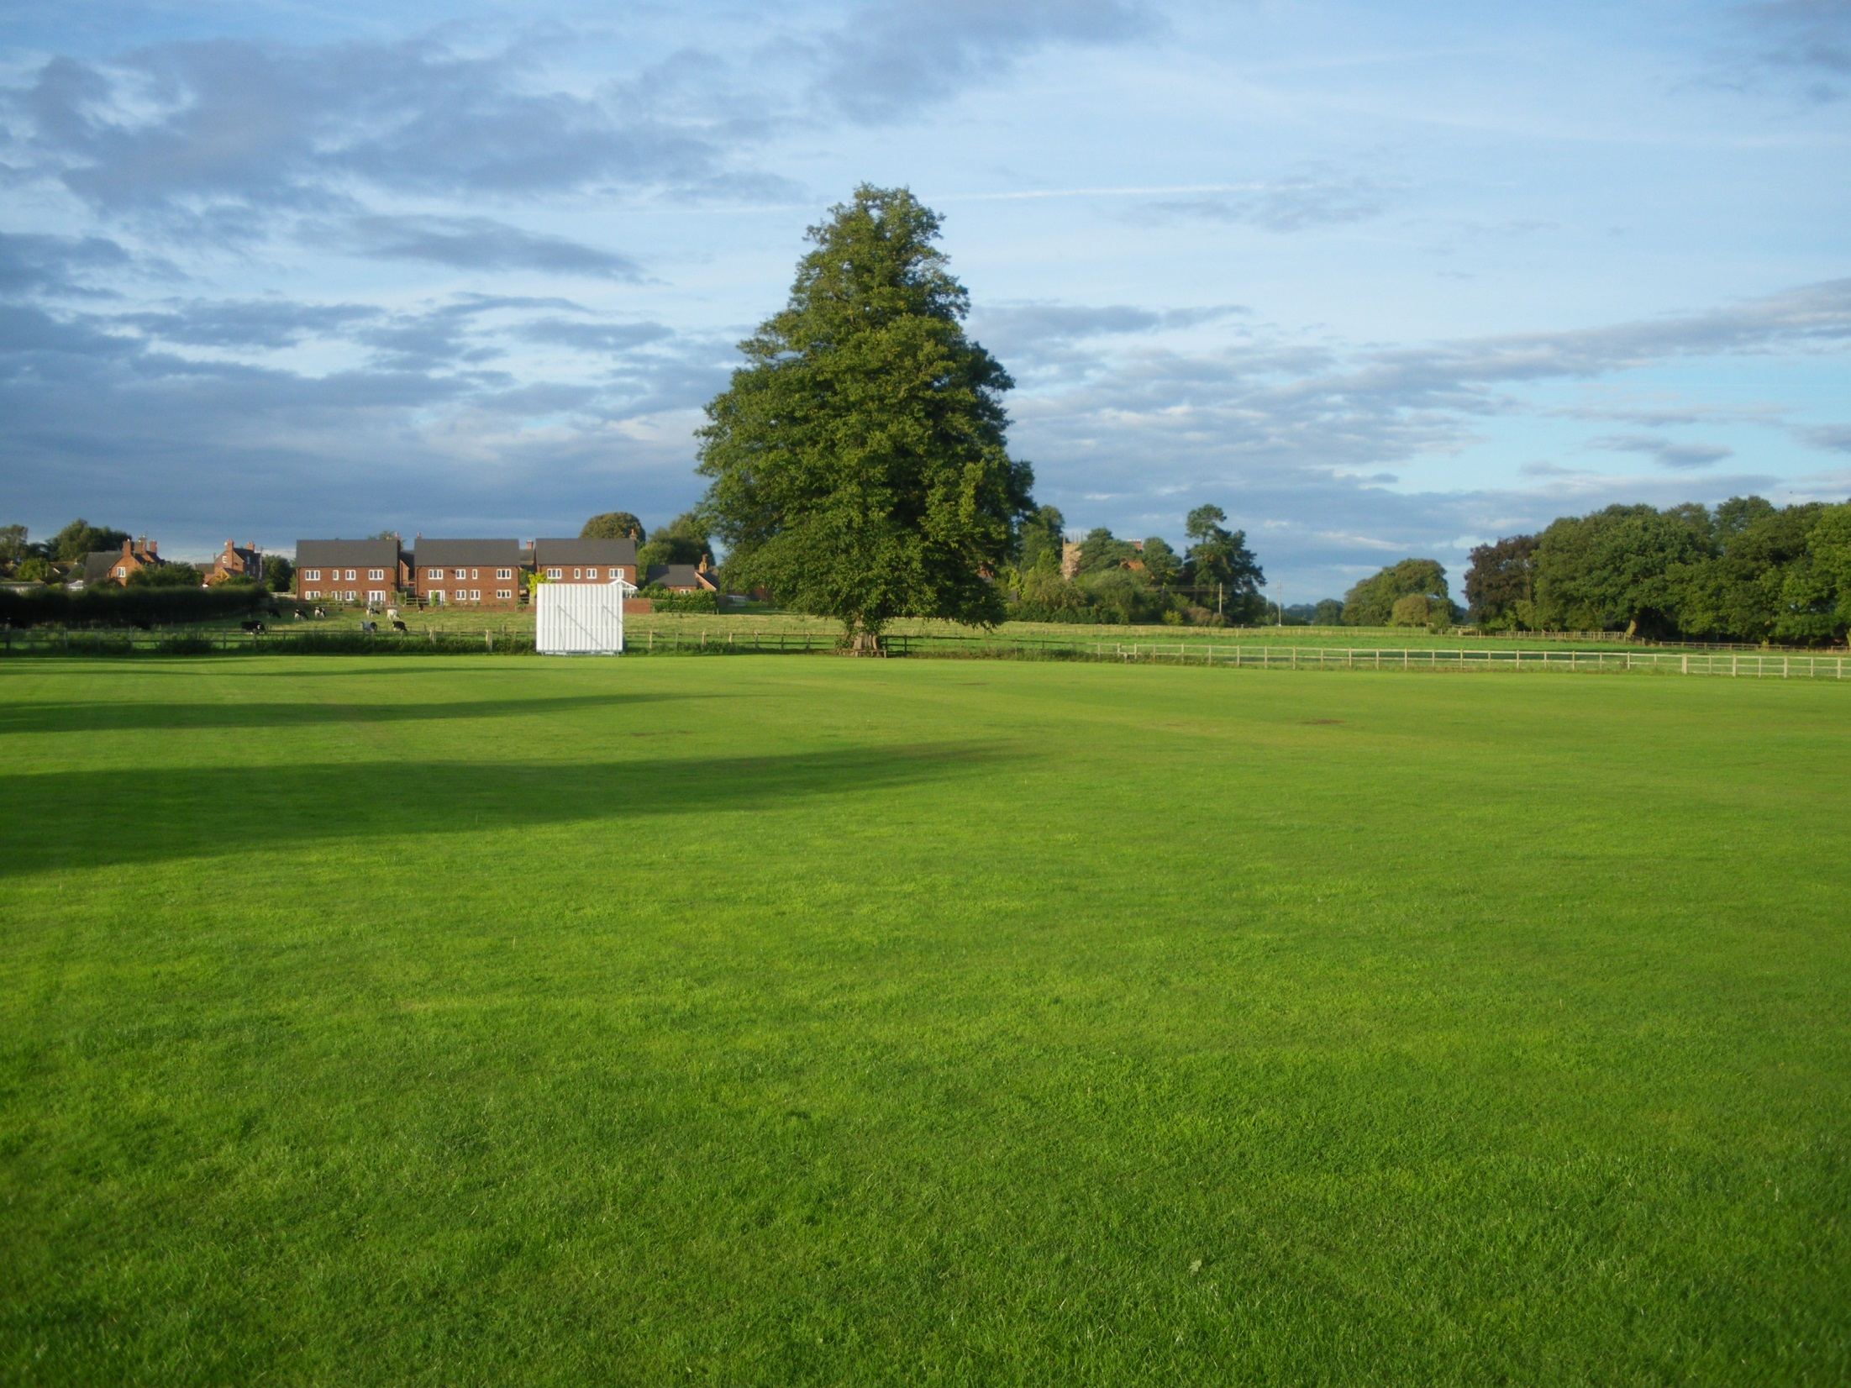
The Government, within their Planning Practice Guidance, refer planning authorities to Sport England ‘s
“Assessing needs and opportunities guide for outdoor sport facilities “(July 2014).
The guide, in part, seeks to replace the previous document:
“Assessing needs and Opportunities: a Companion Guide to Planning Policy Guidance Note 17 (PPG17)” (ODPM/DCLG, 2002) which was cancelled by the Government on the 6th March 2014.
It is important to note, at this point , that the guide only focuses on the need for formal sport and that the guide according to Sport England ,“is not intended to be used for assessing play, informal activities or wider open space needs.”

Slide 5
A Planning Tool
SPORT
PLAY
RECREATION
OPEN SPACES
OPPORTUNITIES
Needs assessments form the basis of a number of applications in a planning and non-planning setting, including:
Sport, play and recreation facility development.
Planning policy development.
Infrastructure planning (including the use of Community Infrastructure Levy Funds).
Developing an evidence base for funding bids and to influence investment decisions.

Slide 6
Robust up-todate evidence
SPORT
PLAY
RECREATION
OPEN SPACES
OPPORTUNITIES
When considering the robustness of a needs assessment Sport England make it clear that assessments should be no more than 3-years old to account for changes and to ensure, the supply and demand analysis is still valid and robust.
They add `whilst it may not be necessary to update the whole evidence base, updating of key information will be required where evidence is over 3-years old’.

Slide 7
Question
How many of you here today have been involved in the creation of a robust open space needs assessment for Sport, Play and Recreation Facilities?
How many of you have used the evidence from an open space needs assessment to access community infrastructure levy funds, towards the provision of play, sport or recreation facilities?

Slide 8
Play Area Provision Report – March 2015
A report by Shropshire Council Officers in March 2015 indicated that:
“Shropshire Council did not have a play strategy in place”.
“Since the introduction of community infrastructure levy monies in 2012 there had been no CIL money specifically allocated towards developing new play areas even though parish and town councils referenced play as a `priority’ in their place plans”.
“Since the introduction of CIL in 2012 there had been no new 106 agreement monies made available for the development of play facilities.
Notably, Shropshire Council did not have a robust up-to-date needs assessment in place, which could provide vital evidence to protect, provide and enhance facilities, as outlined in NPPF73.
(Source: Shropshire Council ‘s Play Area Provision Report; March 2015)

Slide 9
North West England Local Planning Authorities
SPORT
PLAY
RECREATION
OPEN SPACES
OPPORTUNITIES
Current on-going research of over 20 local planning authorities across the North West of England would suggest that…
> Many do not have robust up-to-date needs
assessments in place, as required by the national planning policy framework.
> Many are using playing pitch strategies instead, to inform their policy planning.
> Many are using out-dated open space needs assessments, based on the old PPG17 typology.

Slide 10
Question
If no needs assessment has been done, no play strategy been done, and no funds allocated towards play facility provision in an area…
Who are the losers?
And what can be done about it?

Slide 11
PLAY
SPORT
RECREATION
OPEN SPACES
OPPORTUNITIES
It should be noted that it is not only local planning authorities that can provide a local open space needs assessment.
Town and Parish Councils, as well as local sport clubs, schools and community groups could be proactive in initiating such a need assessment, depending on their own objectives.

Slide 12
PLAY
SPORT
RECREATION
OPEN SPACES
OPPORTUNITIES
The Playing field movements focus is towards enabling the right facilities to be provided in the right places.
Sport England aims to ensure positive planning for sport based on robust and up-to-date assessments of need for all levels of sport and all sectors of the community.

Slide 13
PLAY
SPORT
RECREATION
OPEN SPACES
OPPORTUNITIES
Sport England, Fields In Trust, and the Playing Field Movement share common planning objectives.
They all seek to PROTECT facilities from loss, as a result of redevelopment;
ENHANCE existing facilities through improving their quality, accessibility and management;
And support the PROVISION of new facilities, which meet participation demands now and in the future.

Slide 14
Stand Alone Needs Assessment
Shropshire Playing Fields Association, in collaboration with Church Stretton Town Council, have now produced an Open Space Needs Assessment for Sport, Play and Recreational facilities on three key open space sites:
The School Sport Pitches
The Recreation Ground
The Town Park
The Town Council are now in a strong position to put forward a Sport, Play and Recreation facilities strategy, based on robust up-to-date evidence of local need to their community.

Slide 15
Question
Does this represent an opportunity for the Sport and Play Construction Industry to come together to produce their own stand alone “Open Space Needs Assessments” for Sport, Play and Recreational facilities?
If so, then the said needs assessments could be based on a range of geographical sites ;
New development sites
School sites
Districts
Villages
Towns
Regions
Enabling the Industry to produce vital design, management and maintenance evidence that could be used to inform local plans, when local facility strategies are being written for local communities.

Slide 16
Question
How much more funding would the Sport and Play Construction Industry be accessing
if local planning authorities were to provide appropriate robust up-to-date “open space needs assessments” as required by the National Planning Policy Framework?

Slide 17
Playing Pitch Strategies
Our evidence would seem to indicate that where an open space needs assessment has not been done some local planning authorities are relying on “playing pitch strategy documents” to inform planning policy makers.

Slide 18
PLAYING PITCH STRATEGY?
SPORT
PLAY
RECREATION
OPEN SPACES
OPPORTUNITIES
We believe a playing pitch strategy should not be used as a substitute for a needs assessment.
An open space needs assessment is an essential planning tool meeting national planning policy guidelines.
A playing pitch strategy is best used to support the needs and interests of individual sports groups and governing bodies of sport.

Slide 19
Playing Pitch Strategy Limitations
An outcome of the needs assessment project for Church Stretton was to discover that the Town Council were making decisions in their Town Plan based on a playing pitch strategies carried out in 2010.
A playing pitch study following Sport England guidelines often encompasses an assessment for the requirements of just four outdoor sports.
football, cricket, rugby and hockey.
It does not look at secondary usage of a playing field.

Slide 20
Identified as a “priority” through the “Playing Pitch Improvement plan”.
Town Plan states: £250,000 to be spent as a priority on a replacement sports pavilion at the Church Stretton Recreation Ground.
PRIORITY: Shropshire Council, Church Stretton Town Council, Energize (Shropshire, Telford and Wrekin County Sports Partnership), Sport England.
Cost: £250,000 Funding secured: £50,000 Sport England, £200,000 Neighbourhood Fund, (CIL Local).

Slide 21
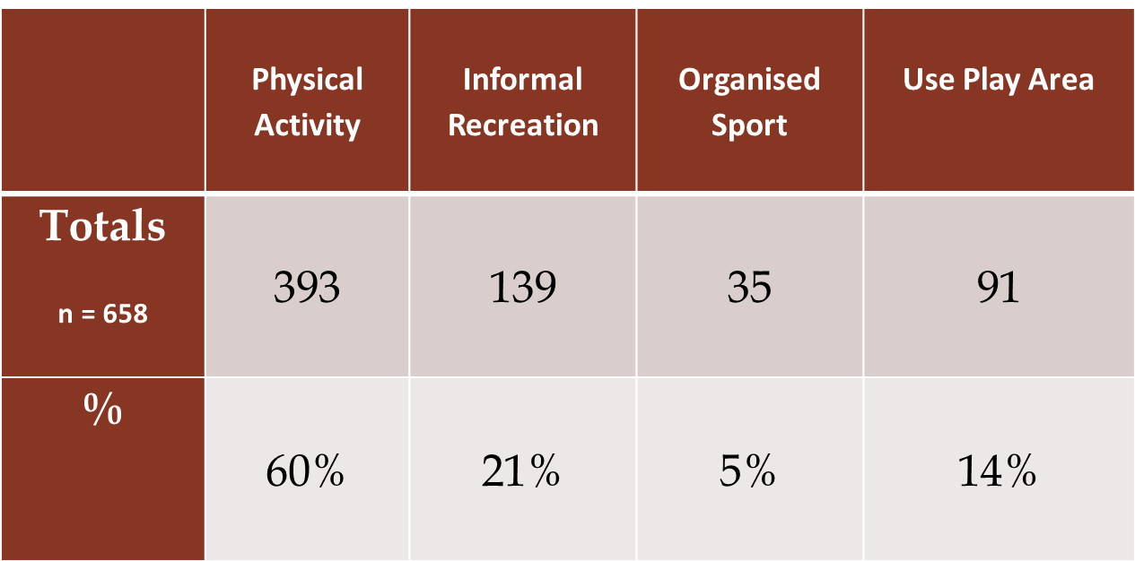
Purpose of visit to the recreation ground

Slide 22
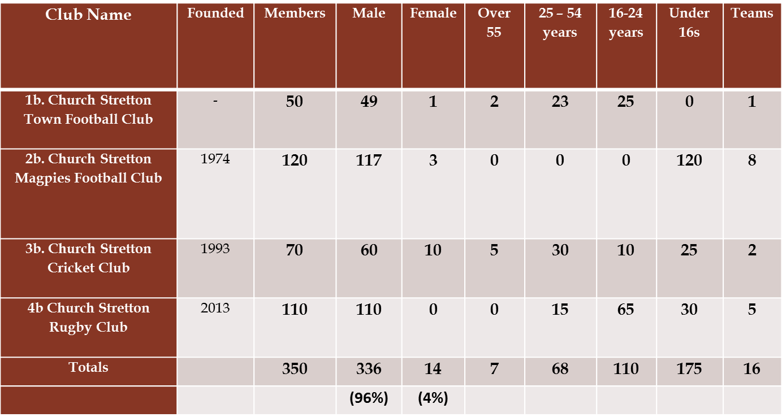
Sport Club User Profiles

Slide 23
PLAY
SPORT
RECREATION
OPEN SPACES
OPPORTUNITIES
£250,000 is being spent on a replacement pavilion that will meet the needs of just 5% of those that use the recreation ground of which just 4% of those 5% are female.
The needs of the other 95% of users were not taken into account through the application of the playing pitch strategy.
A needs assessment considers every-ones needs

Slide 24
PLAY
SPORT
RECREATION
OPEN SPACES
OPPORTUNITIES
The Playing field movements focus is towards enabling the right facilities to be provided in the right places.
Sport England aims to ensure positive planning for sport based on robust and up-to-date assessments of need for all levels of sport and all sectors of the community.
We believe there is sufficient evidence to suggest that this is not happening in many of our local communities today.
Thank you for listening

Slide 25
PLAY
SPORT
RECREATION
OPEN SPACES
OPPORTUNITIES
PLAY
Play is not a separate activity, but is an integral part of existing activities.
Reasonable to assume that play is an integral part of sport and recreation.
Therefore play needs to be understood and applied in partnership with each activity, rather than in isolation.
(Wolfendon Report: 1960)

